Slide 1
Layout
Musadaq Mansoor
(Credits to Marty Stepp and Stanford Computer Science)

Slide 2
Static / Dynamic Sizing and Positioning
How does the programmer specify where each component appears, how big each component should be, etc.?
Absolute positioning (C++, C#, others):
Programmer specifies exact pixel coordinates of every component.
"Put this button at (x=15, y=75) and make it 70x31 px in size."
Layout managers (Java, Android):
Objects that decide where to position each component based on some general rules or criteria.
"Put these four buttons into a 2x2 grid and put these text boxes in a horizontal flow in the south part of the app."
More flexible and general; works better with a variety of devices.

Slide 3
ViewGroup as Layout
ViewGroup superclass represents containers of widgets/views
layouts are described in XML and mirrored in Java code
Android provides several pre-existing layout managers; you can define your own custom layouts if needed
layouts can be nested to achieve combinations of features
in the Java code and XML:
an Activity is a ViewGroup
various Layout classes are also ViewGroups
widgets can be added to a ViewGroup, which will then manage that widget's position/size behavior

Slide 4
XML
XML : a language for describing hierarchical text data.
Uses tags that consist of elements and attributes. Tags can be nested.
Some tags are opened and closed; others self-close.
<element attr=“value” /> (self closing)
<elements attr=“value” attr=“value”> … </elements>
Example
<course name="Mobile App" semester="spring19">
<teacher> Musadaq </teacher>
</course>

Slide 5
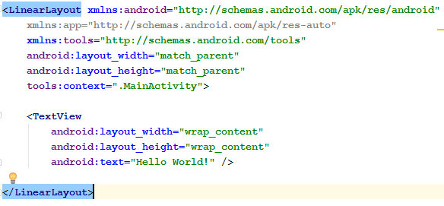
Changing Layouts
go to the Text view for your layout XML file
modify the opening/closing tags to the new layout type, e.g. LinearLayout
now go back to Design view and add widgets

Slide 6
Linear Layout
lays out widgets/views in a single line
orientation of horizontal (default) or vertical
items do not wrap if they reach edge of screen!

Slide 7
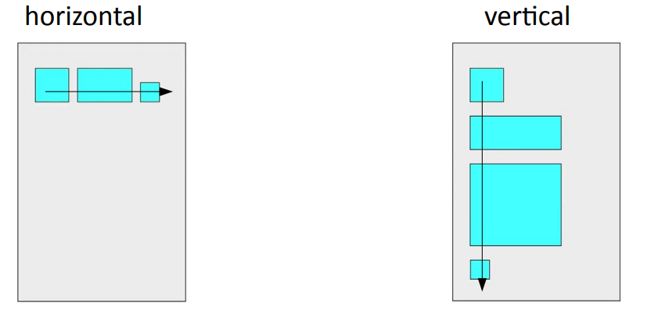

Slide 8
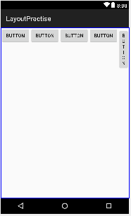
Example 1
<LinearLayout ...
android:orientation="horizontal"
tools:context=".MainActivity">
<Button ... android:text="Button 1" />
<Button ... android:text="Button 2 Hooray" />
<Button ... android:text="Button 3" />
<Button ... android:text="Button 4
Very Long Text" />
</LinearLayout>

Slide 9
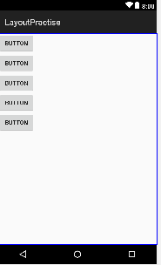
Example 2
<LinearLayout ...
android:orientation=“vertical"
tools:context=".MainActivity">
<Button ... android:text="Button 1" />
<Button ... android:text="Button 2 Hooray" />
<Button ... android:text="Button 3" />
<Button ... android:text="Button 4
Very Long Text" />
</LinearLayout>

Slide 10
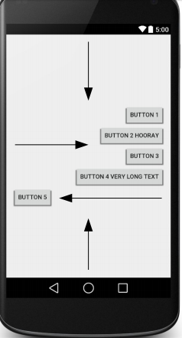
Gravity
gravity: alignment direction that widgets are pulled
top, bottom, left, right, center
combine multiple with |
set gravity on the layout to adjust all widgets;
set layout_gravity on an individual widget
<LinearLayout ...
android:orientation="vertical"
android:gravity="center|right">
<Button ... android:text="Button 1" />
<Button ... android:text="Button 2 Hooray" />
<Button ... android:text="Button 3" />
<Button ... android:text="Button 4 Very Long Text" />
<Button ... android:text="Button 5"
android:layout_gravity="left" />
</LinearLayout>

Slide 11
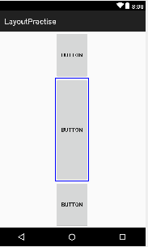
Weight
weight: gives elements relative sizes by integers
widget with weight K gets K/total fraction of total size
<LinearLayout ...
android:orientation="vertical">
<Button ... android:text="B1"
android:layout_weight="1" />
<Button ... android:text="B2"
android:layout_weight="3" />
<Button ... android:text="B3"
android:layout_weight="1" />
</LinearLayout>

Slide 12
Widget box model
content: every widget or view has a certain size (width x height) for its content, the widget itself
padding: you can artificially increase the widget's size by applying padding in the widget just outside its content
border: outside the padding, a line around edge of widget
margin: separation from neighboring widgets on screen

Slide 13
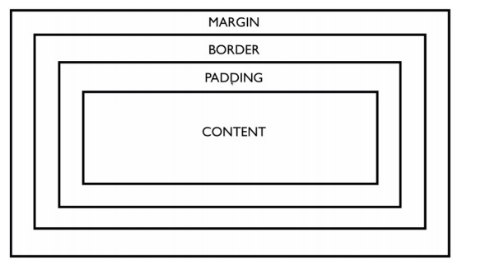

Slide 14
Padding
padding: extra space inside widget
set padding to adjust all sides; paddingTop, Bottom, Left, Right for one side
usually set to specific values like 10dp
(some widgets have a default value ~16dp)

Slide 15
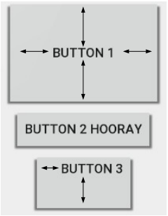
Padding
<LinearLayout ...
android:orientation="vertical">
<Button ... android:text="Button 1"
android:padding="50dp" />
<Button ... android:text="Button 2 Hooray" />
<Button ... android:text="Button 3"
android:paddingLeft="30dp"
android:paddingBottom="40dp" />
</LinearLayout>

Slide 16
Margin
margin: extra space outside widget to separate it from others
set layout_margin to adjust all sides; layout_marginTop, Bottom, Left, Right
usually set to specific values like 10dp
(set defaults in res/values/dimens.xml)

Slide 17
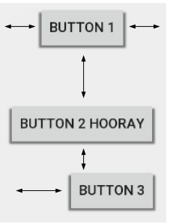
Margin
<LinearLayout ...
android:orientation="vertical">
<Button ... android:text="Button 1"
android:layout_margin="50dp" />
<Button ... android:text="Button 2 Hooray" />
<Button ... android:text="Button 3"
android:layout_marginLeft="30dp"
android:layout_marginTop="40dp" />
</LinearLayout>

Slide 18
Individual Widget Size
width and height of a widget can be:
wrap_content : exactly large enough to fit the widget's content
match_parent : as wide or tall as 100% of the screen or layout
a specific fixed width such as 64dp (not usually recommended)
dp = device pixels; dip = device-independent pixels; sp = scaling pixels
<Button ...
android:layout_width="match_parent"
android:layout_height="wrap_content" />

Slide 19
Thanks
Any Questions?

